Slide 1

Pentris bots
Group 25

Slide 2
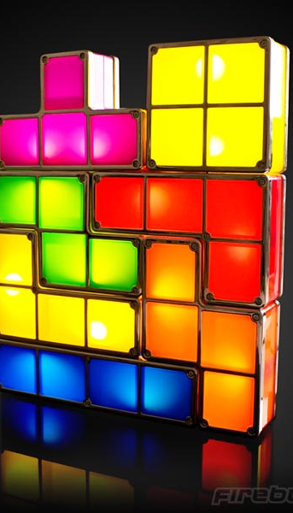
Game
Objective
Limitations
Scoring
This Photo by Unknown Author is licensed under CC BY-SA-NC

Slide 3
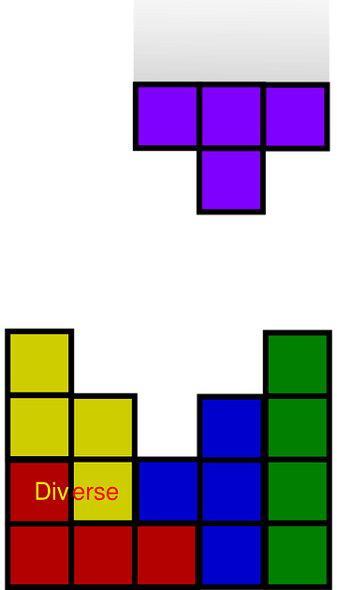
Optimal order
Approach
Algorithm X as a start
Play the game with the given orders
Results

Slide 4

Bots
Q-bot
G-bot
This Photo by Unknown Author is licensed under CC BY-SA

Slide 5
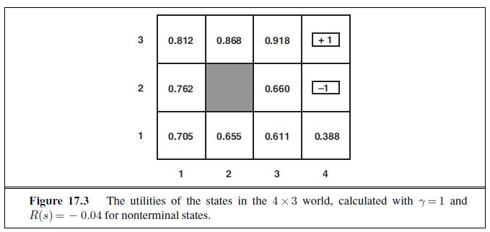
Q-bot
This Photo by Unknown Author is licensed under CC BY-SA

Slide 6
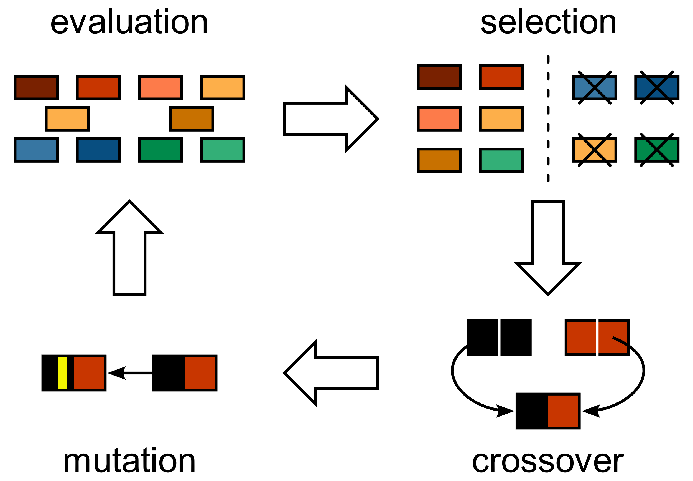
G-bot
This Photo by Unknown Author is licensed under CC BY-SA

Slide 7
G-bot data
Put in graphs of the G-bot (provided by Sam) per ‘upgrade’

Slide 8
Bot comparison
 | Q-bot | G-bot
Score | Unknown | 4500
Rows cleared | Unknown | 15
Time to train | None | High
Required processing power | High | Very low
‘Cleverness’ | Medium | High

Slide 9
What we learned
Communication
Division of work

Slide 10

Planning phase 3
Visualization: week 1 and 2
Research: week 1
Implementation: end of week 1, start of week 2 and polish in week 3
Report: introduction, format, etc week 1, finish in week 3
Presentation: week 3
This Photo by Unknown Author is licensed under CC BY-SA

